Slide 1
ACST-2
Carotid Stenting vs Surgery
- time to embrace the new technology?
Alison Halliday
Professor of Vascular Surgery, University of Oxford
Essex Stroke Research Day, Southend
22nd March 2016

Slide 2
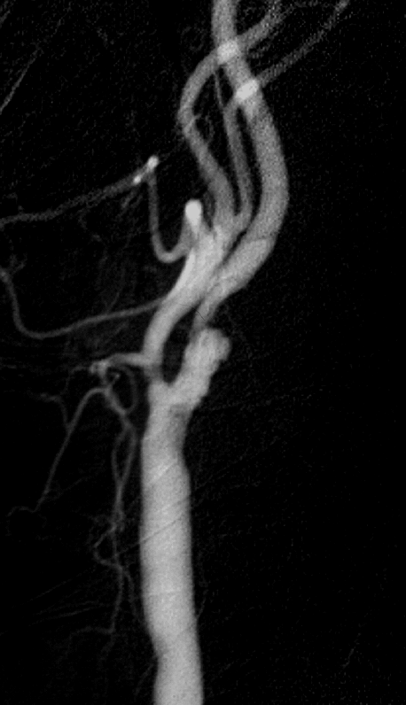
Asymptomatic carotid artery stenosis: narrowing that has not yet caused a stroke
Might intervention prevent stroke?

Slide 3
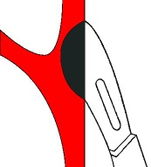
ACST-1
3120 patients, severe stenosis eligible for CEA
randomized to:
Immediate CEA
vs
‘control’
(no CEA unless symptoms occur)
Notes:
3

Slide 4
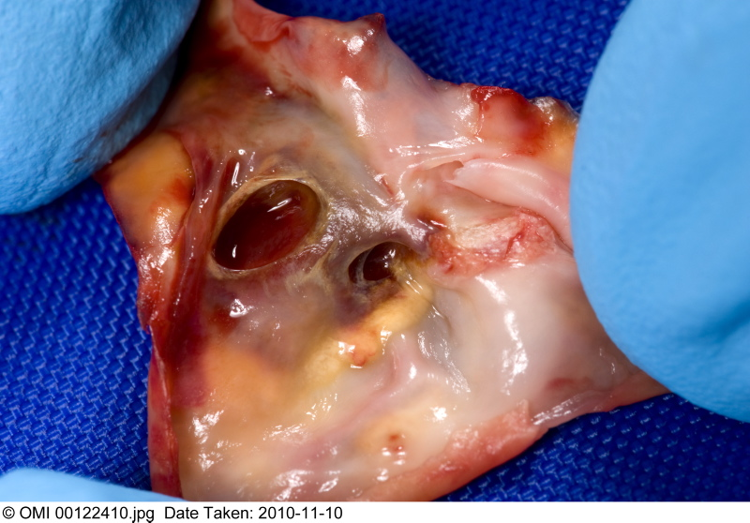
‘Asymptomatic’ - a misnomer?
41% ACST-1 patients had h/o stroke-type symptoms or CT brain infarcts, they were at higher stroke risk ~ 3% yr

Slide 5
ACST-1: CEA reduces 10-year stroke risk by 6-7%

Slide 6
Statins – lower overall stroke risk, and enable same 6% absolute benefit from surgery

Slide 7
ACST-1 – peri-operative risk
reduced by statin therapy
ACST-1
4.3%
2.2%

Slide 8
Since ACST-1: Falling risks from CEA and CAS
Reduced procedural risk for CEA (Statins)
Reduced procedural risks for CAS…

Slide 9
Falling risks from CEA and CAS
Reduced procedural risk for CEA (Statins)
Reduced procedural risks for CAS…

Slide 10
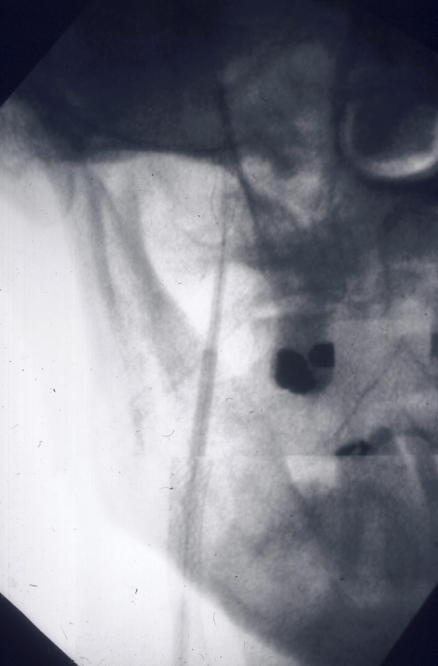
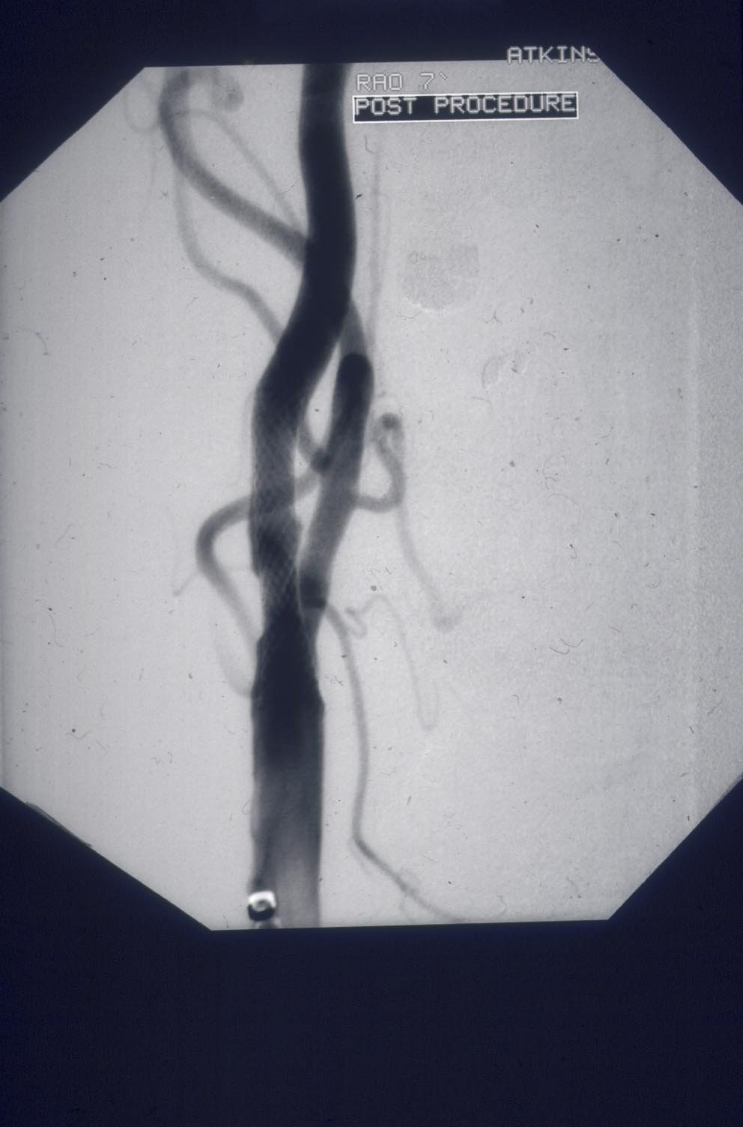
Techniques, devices, experience have all
changed since the early symptomatic trials…
Open vs closed-cell stent design
Closed–cell safer?
Now – have FLOW-reversal systems, direct puncture, membrane stents..reduces risk of distal embolisation

Slide 11
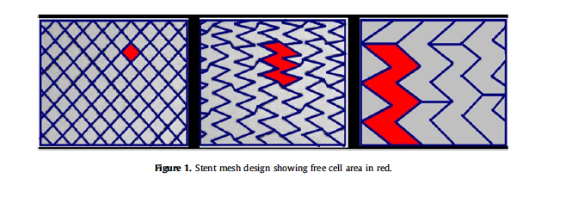
Open and closed-cell stents

Slide 12
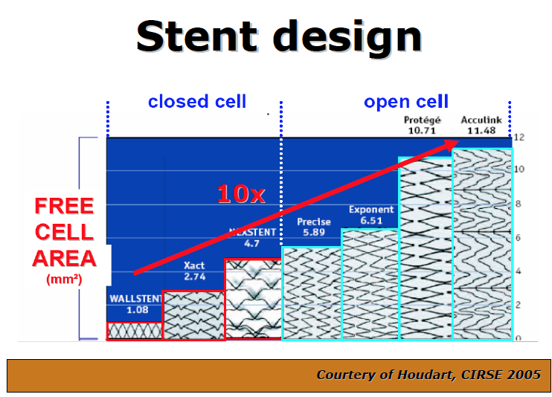

Slide 13
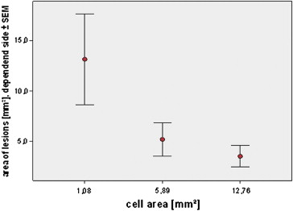
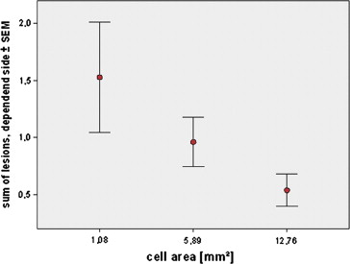
Comparison of Stent Free Cell Area and Cerebral Lesions after Unprotected Carotid Artery Stent Placement
Correlation of free cell area with total MRI lesion area (L) or lesion numbers (R)
I.Q. Grunwald, W. Reith, K. Karp, P. Papanagiotou, H. Sievert, S. Walter et al Eur Jour Vasc Endovasc Surgery 2012;43:10–14

Slide 14
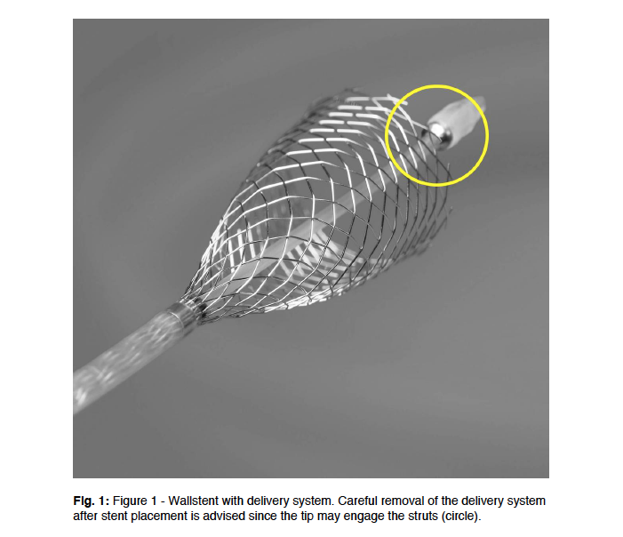
The Boston Wallstent
(closed-cell)

Slide 15
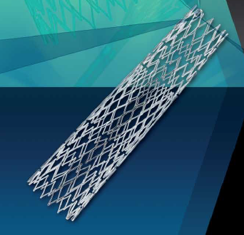
Cristallo Ideale (Hybrid)
Open Cell Stent with Closed Cell Design
Proximal and distal sections – open cell, enhanced flexibility
Central closed cell
section

Slide 16
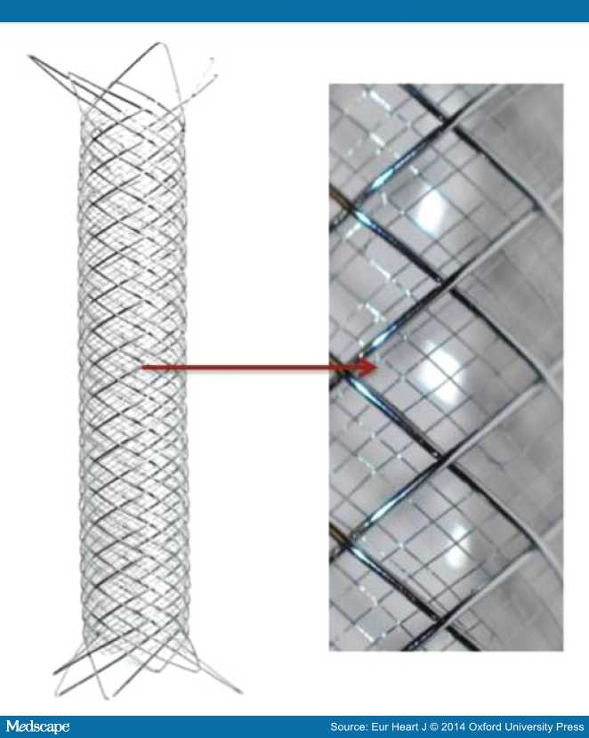
Membrane
Stent
Roadsaver

Slide 17
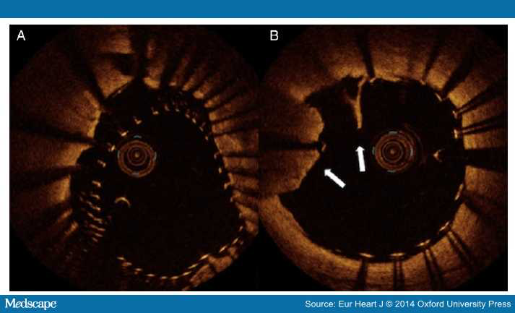

Slide 18
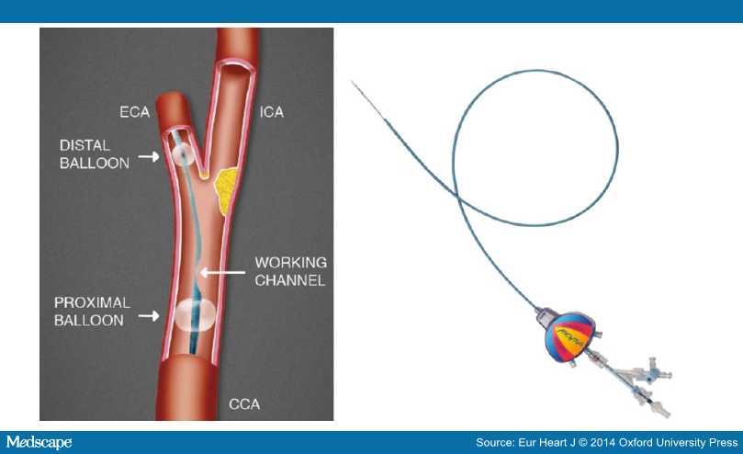
MoMa
Flow-reversal
protection device

Slide 19
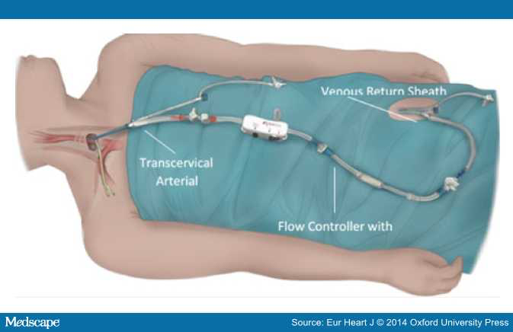
Roadsaver/Silk Road – avoids aortic arch, controlled flow reversal

Slide 20
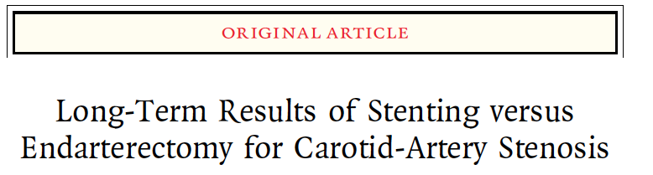
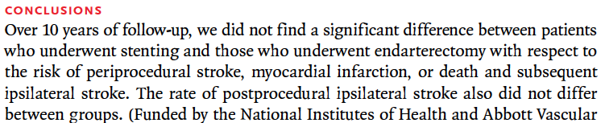

CREST Trial - Symptomatic and Asymptomatic

Slide 21
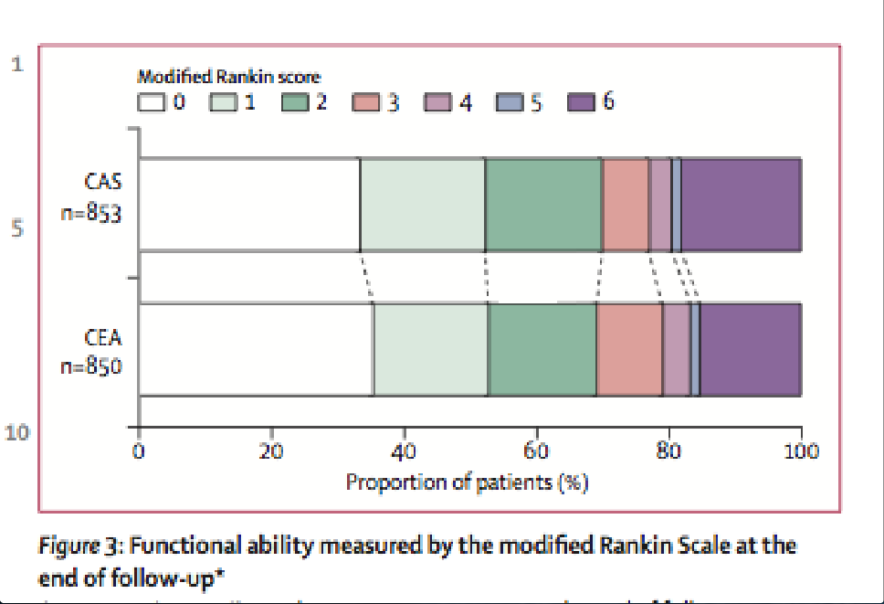
ICSS 4 year follow up
(Lancet, Oct 2014)

Slide 22
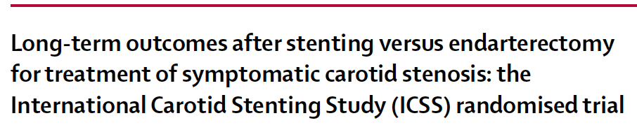
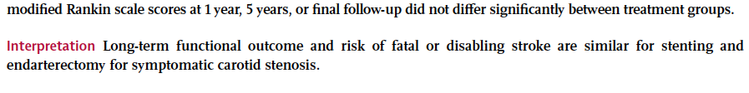
ICSS Trial – symptomatic patients

Slide 23
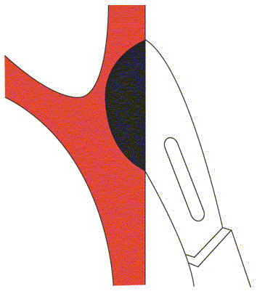
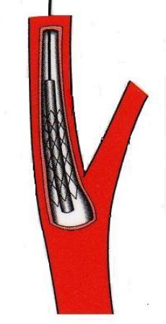


Treatment for asymptomatic carotid artery stenosis:
surgery or stenting?
Randomise patients considered to be at high future stroke risk, suitable for both procedures

Slide 24
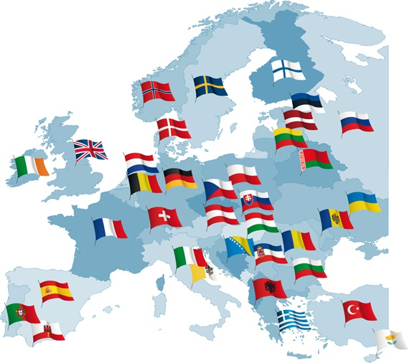
ACST-2
A very European Trial

Slide 25
Recruitment by Country – March 2016

Slide 26
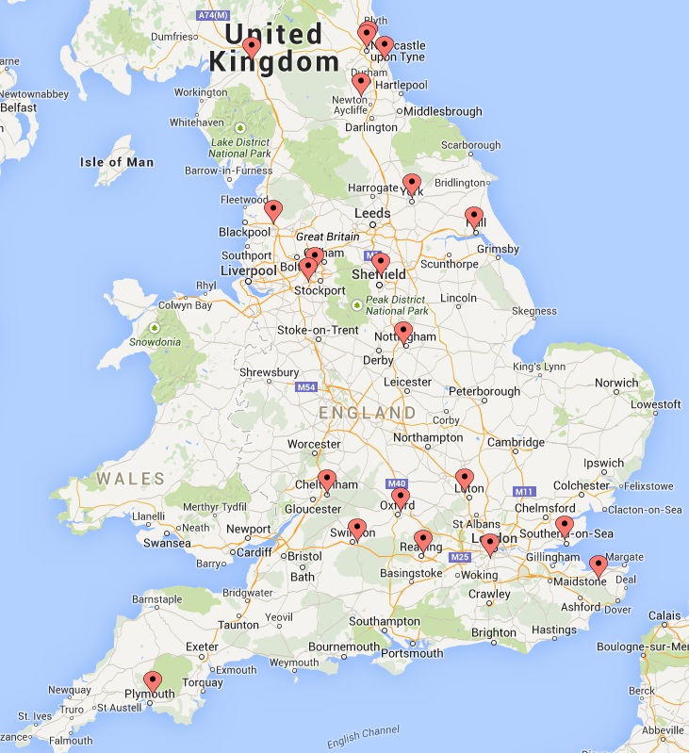
UK Centres in ACST-2

Slide 27
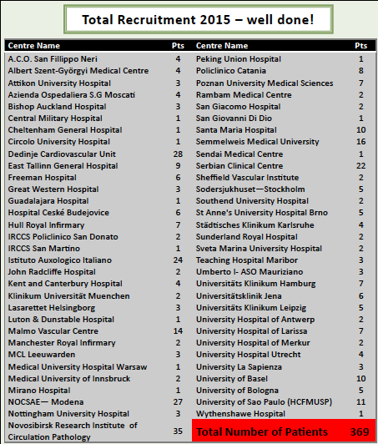
2015 Recruitment
14/62 randomising centres from UK
Overall, 17% ACST-2 patients are from UK

Slide 28
Southend and ACST-2
(UK total 346 patients)
Freeman Hospital, Newcastle 73
Bishop Auckland 47
Kent and Canterbury 35
Nottingham 26
Wythenshawe, Manchester 26
Sunderland 18
Southend 15 patients
Oxford 15
Royal Victoria, Newcastle 14
Sheffield 13
Liverpool 13
Hull 11
James Cook
St Mary’s
North Durham
Luton & Dunstable
Manchester Royal
Cumbria
Cheltenham
Swindon
Plymouth
Preston
Royal London
<10 patients each

Slide 29
ACST-2
Surgery vs Stenting - Target 3600 patients
2125
today

Slide 30
ACST-2 Completeness of Follow Up
Forms returned 2013 | 100%
2014 | 81%
2015 | 95%

Slide 31
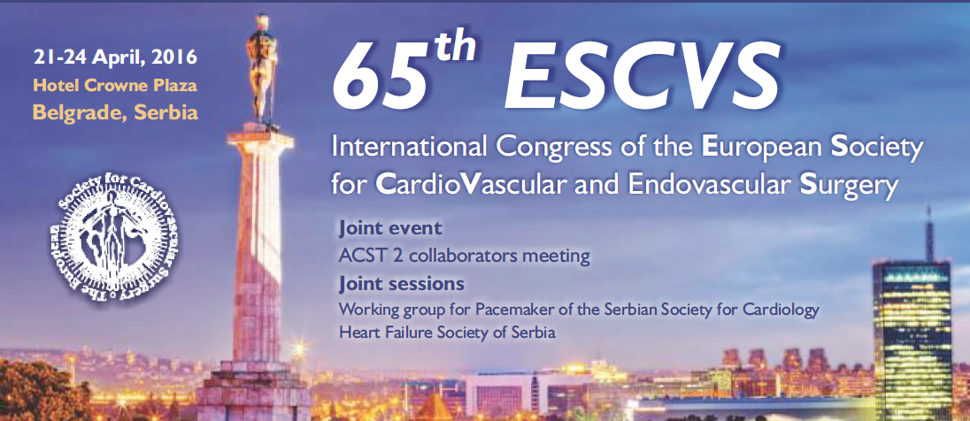
ACST-2 Collaborators’ meeting Belgrade, 20-21st April 2016
Work hard and complete recruitment by December 2019!

Slide 32
ACST-2:CEA vs CAS
Sex, Age, Co-morbidities:
Men 70%
Mean age 69 years
Ischaemic heart disease 36%
Diabetic 30%
Renal impairment 6%

Slide 33
ACST-2: CEA vs CAS
Stroke risk factors:
Atrial Fibrillation 6%
Age >75 yrs 25.5%
Previous stroke symptoms or infarct 43%
Medical Treatments at entry:
BP drugs 84%
Lipid-lowering 80%
Anti-thrombotic 85.5%
direct patient feedback every year (drug names and doses)

Slide 34
Drug therapy at 2015 follow up
Antithrombotic 96%
(aspirin, asasantin, clopidogrel,
single/dual APT, warfarin, NOAC)
BP Medications 84%
(Named drugs and doses)
Lipid-lowering 85%
(named drugs and doses)

Slide 35
ACST-2 Stents | Cerebral Protection | Devices (87%)
Wallstent | Emboshield | Filter
Cristallo Ideale Abbott Xact | Filterwire | Filter
Cordis Precise | Mo. Ma Spider | Prox occ Filter
Ev3 Protégé® RX Abbott Acculink | Accunet AngioGuard | Filter Filter
Boston Adapt Sinus | Gore Flow Reversal | Prox occ
ViVEXX | Twin One | Distal balloon
Roadsaver Inspire | FiberNet Viatrac | Filter
Zilver, Mer

Slide 36
ACST-2 Stents | Protection Devices | Type
Wallstent (1.08mm²) | Emboshield Filterwire | Filter Filter
Xact (2.54mm²) Boston Adapt (4.4mm²) | Accunet AngioGuard Spider Fibernet Viatrac | Filter Filter Filter Filter
Precise (5.89mm²) ViVEXX (closed,?mm²) | Mo. Ma | Prox occ
Protégé® RX (10.71mm²) Acculink (11.48mm²) | Gore Flow Reversal | Prox occ
Cristallo Ideale (Hybrid) Sinus (Hybrid) | Twin One | Distal balloon
Roadsaver (membrane) Inspire (membrane)
Zilver (3) Mer (1)

Slide 37
ACST-2: Blinded Procedural hazards
1500 patients (≤ 30 days)
Disabling/fatal stroke or fatal MI
(much lower than in symptomatic trials)
ACST-1 (CEA) 1.7%
ACST-2 (CEA and CAS) 1.0%
‘blinded’
Despite increasing age and risk factors for stroke,
interventional hazards in ACST-2 are lower than ACST-1
37

Slide 38


NICE(2013) recommends randomising in ACST-2
Randomised Trials need to be large…… and designed to answer clinically important questions
UK Stroke and International Guidelines use ACST evidence – the world’s largest vascular trials (many patients, long follow up)
ACST-2 is successfully enrolling patients, many have a higher than expected stroke risk, because of previous symptoms and cerebral infarcts; we will be able to compare outcomes in large subgroups like this
This will change interventional stroke prevention treatment, Surgeons in Europe, US, Australasia, do CAS as well as CEA…why not here in the UK?
Thank you Southend – please keep randomising!

