Slide 1



NIHR Oxford Biomedical Research Centre
Centre for Prevention of Stroke and Dementia
Vascular dementia
TIA, stroke and dementia in the Oxford Vascular Study
Sarah T Pendlebury
Consultant Physician and Associate Professor
Centre for Prevention of Stroke and Dementia
Nuffield Department of Clinical Neurosciences
and
NIHR Oxford Biomedical Research Centre
and
Departments of Acute Medicine and Geriatrics
John Radcliffe Hospital, Oxford

Slide 2
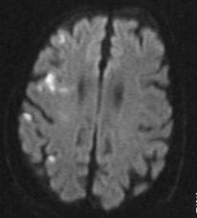
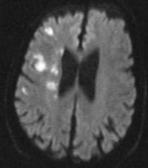
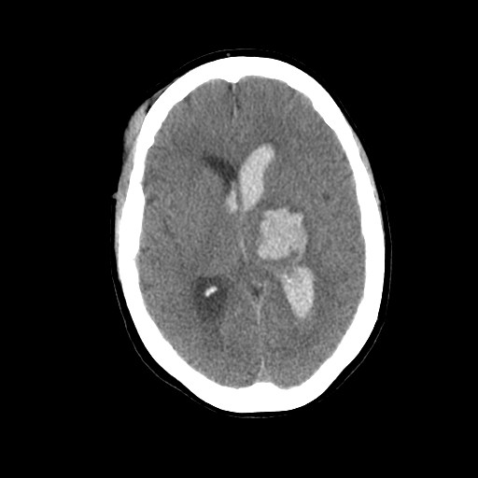
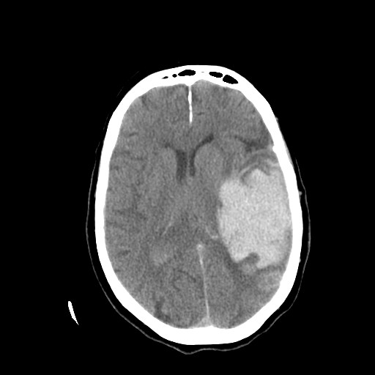
Vascular dementia: definitions and heterogeneity
There is no universally accepted definition for dementia (ICD, DSM)
There is no universally accepted definition for vascular dementia (NINDS-AIREN, DSM, Vas-Cog, VICCS) which is the second most common form of dementia
Large cortical infarcts
Multiple infarcts
Strategic infarcts
Large vessel, small vessel, cardiac
Haemorrhage
Hypertensive
Cerebral amyloid angiopathy
Post-stroke dementia
Silent stroke
White matter disease Co-existent neurodegeneration

Slide 3
Vascular dementia: cognitive profile
Vascular patients have prominent frontal/executive deficits vs early memory deficits in AD. Also apathy, depression, lability
Stroke
Memory
TIA
Stroke
Mean % of maximum subtest score
MMSE
Memory
TIA
Stroke
MoCA
Cerebrovasc Dis. 2012;34(1):48-54.

Slide 4
OxVASC: Dementia in TIA/stroke, 2002-
~100 GPs
>92,000 people
TIA/minor stroke (PMR) OxVASC clinic
Major stroke acute stroke unit
ACS and PVD are interviewed
Ascertainment is via hot pursuit
stroke unit
ED/medical assessment, wards
ambulatory care
And cold pursuit
searches at GP practices
bereavement service
death certificates

Slide 5
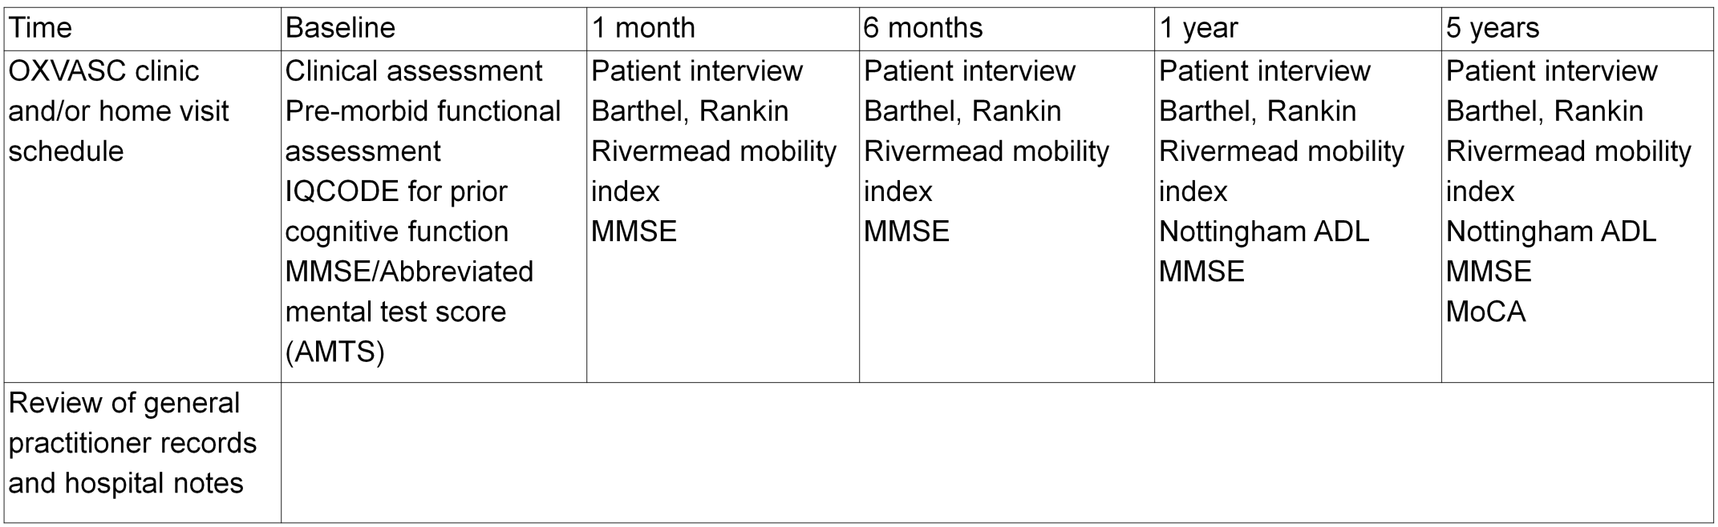
OxVASC: assessments
Pre- and Post-event dementia diagnosis by direct patient assessment supplemented hand-searching of primary care and hospital records (STP)
Study FU includes out-patient study clinic, home visit, telephone and email (including via informant)

Slide 6
OxVASC study design mitigates bias in measured dementia
Selection bias (early death, age, dysphasia, comorbidity, functional status)
Attrition on follow-up (age, frailty)
Stroke 2015

Slide 7
OxVASC preliminary analyses: Pre- and Post-event dementia
What is the risk of dementia after TIA/minor stroke?
Few existing data
TIA and minor stroke cause significant anxiety regarding prognosis.
Concept of “multi-infarct/vascular dementia”
What is the risk after major stroke?
In the context of robust secondary prevention

Slide 8
OXVASC cohorts 1 and 2
ascertained 2002-2007 and 2007-2012
2305 TIA/stroke patients
Demographics and type of event n (%) |  | Risk factors n (%)
Age mean+sd | 74.4+13.0 yrs | Hypertension | 1405 (61)
Male | 1133 (49) | Diabetes mellitus | 328 (14)
Education <12 yrs | 1543 (67) | MI | 256 (11)
TIA | 689 (30) | AF | 469 (20)
Minor stroke | 898 (39) | PVD | 178 (8)
Major stroke | 718 (31) | Current smoker | 323 (14)
Previous stroke | 274 (12)

Slide 9
Pre-event dementia prevalence
Post-event dementia incidence
dementia 5-yr cumulative incidence (%)
dementia prevalence (%)
All (with and without prior stroke)
All (with and without prior stroke)
Without prior stroke
With prior stroke
Without prior stroke
With prior stroke
OxVASC unpublished

Slide 10
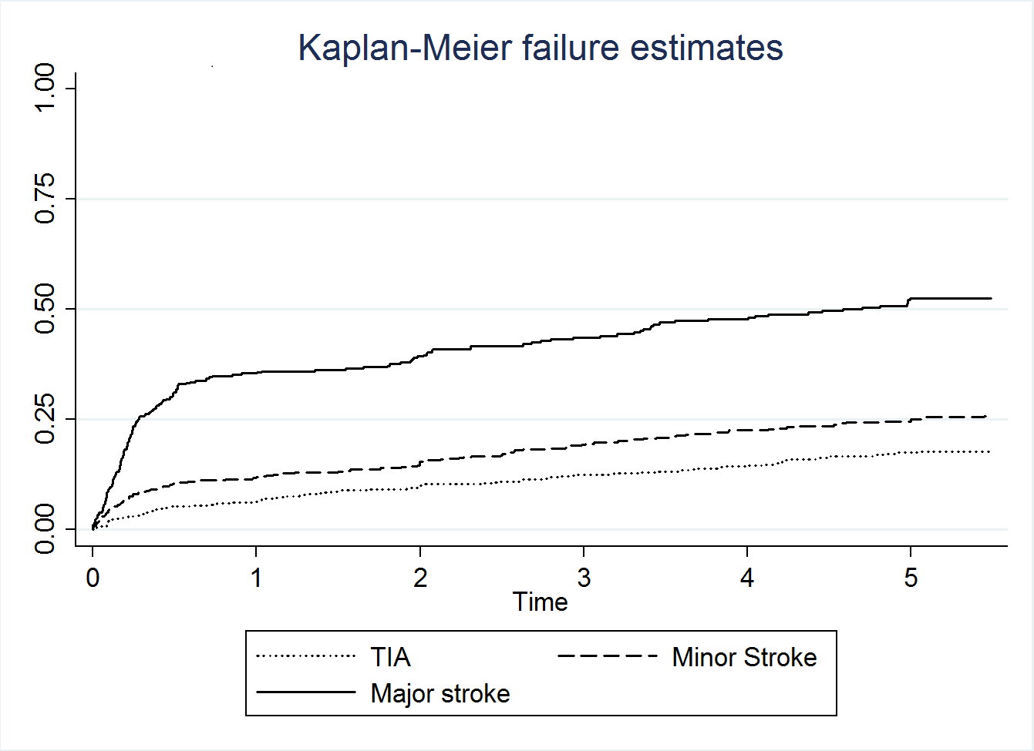
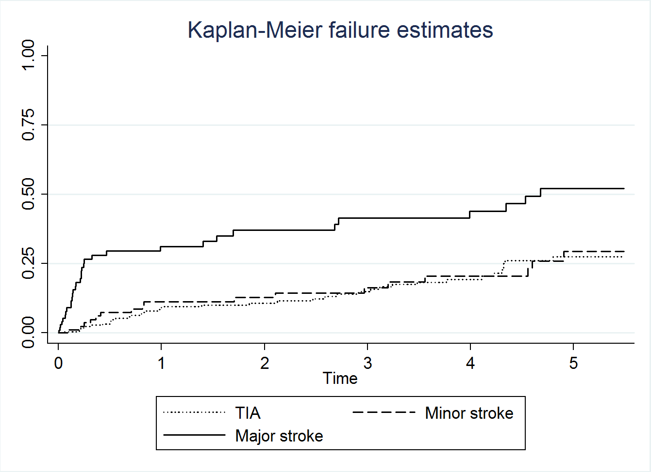
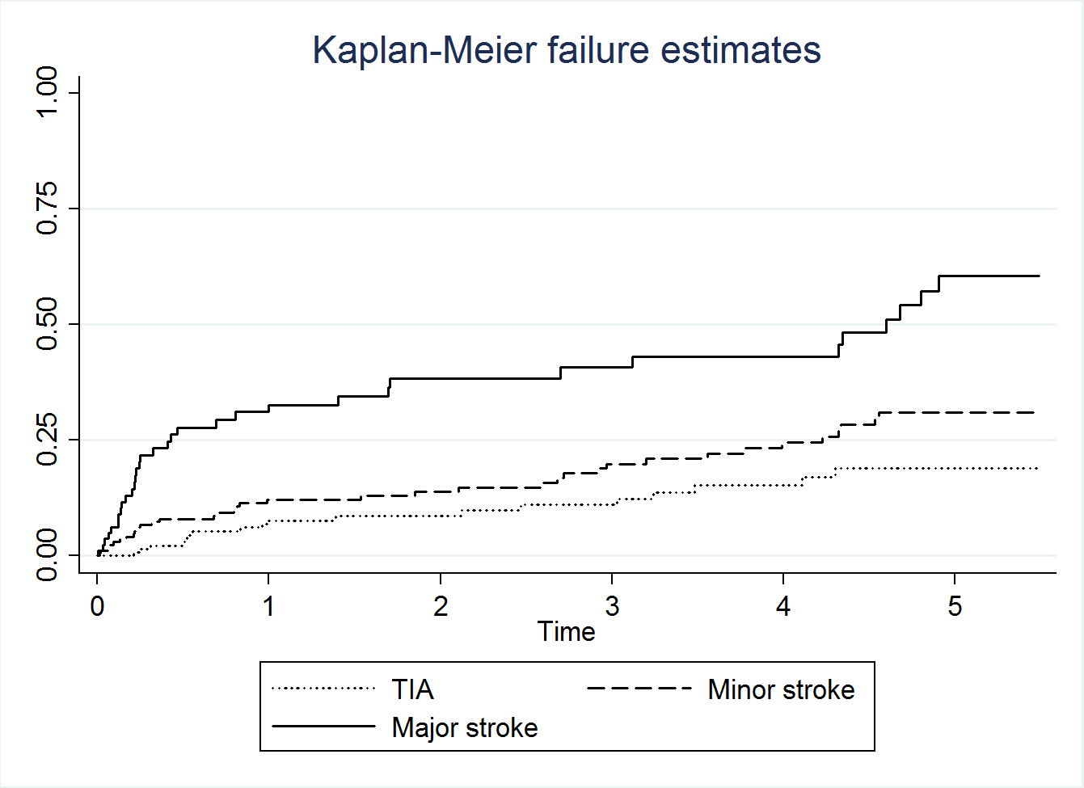
Post-event dementia cumulative incidence to 5 years by event severity
Stroke NIHSS>3
Stroke NIHSS<3
Cumulative incidence of dementia
TIA
After index event
Years after index event, time 0=time of index event
After recurrent event on follow-up, time 0=time of recurrent event
by severity of recurrent event
by severity of index event
Cumulative incidence of dementia
OxVASC unpublished

Slide 11
Factors independently associated with post-event dementia: Vulnerability/lesion impact
Age
Education
(Diabetes) NOT other vascular RFs/stroke subtype
White matter disease
Low baseline cognitive score
Multiple strokes (prior/recurrent, lesions on brain imaging
Dysphasia
Severity (NIHSS)
Shared susceptibility to stroke and dementia
stepwise relationship between severity and dementia risk
genetics, mid-life vascular factors, CAA, cerebral perfusion
OXVASC unpublished

Slide 12
OxVASC dementia rates vs MRCCFAS age- and sex-matched UK population data >65 years
Pre-event dementia: Standardised prevalence ratio
Ranges from 0.70 (0.54-1.0) TIA to 1.90 (1.50-2.40) NIHSS>10
Post-event dementia incidence: Standardised morbidity ratio
Ranges 3.5 (2.8-4.8) TIA to 28.4 (20.9-38.8) NIHSS>6 at 1-year
1.6 (1.1-3.1) TIA to 5.2 (3.3-7.7) NIHSS>6 at 1-5-years
1,5 year survivors: Standardised prevalence ratio
1-year, Ranges 1.2 (0.9-1.6) TIA to 8.1 (6.1-10.6) NIHSS>10
5-years, Ranges 1.5 (1.1-2.0) TIA to 6.5 (4.1-9.8) NIHSS>10
OxVASC unpublished

Slide 13
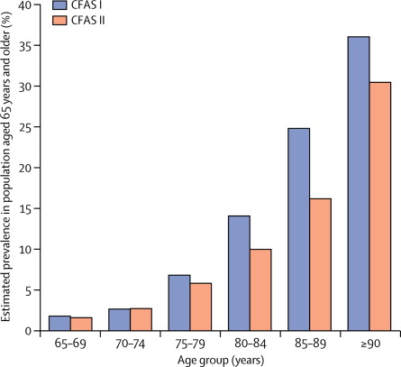
Age-specific dementia prevalence and incidence: evidence for decline over last ~2 decades
MRCCFAS
More decline in men than women
?partly vascular disease reduction
Matthews et al, Lancet. 2013
Matthews et al, Nature Comms 2016
Also Framingham, France, Sweden

Slide 14
Trials
Trials to prevent dementia after stroke have focussed on aggressive management of vascular RFs
Small sample sizes, short FU. No benefit demonstrated
Ihle-Hansen et al, Int J Stroke 2014
Matz et al, Stroke 2015
FINGER: possible benefit of lifestyle and RF interventions in those at high risk of dementia (defined by a risk score)
Ngandu et al, Lancet. 2015

Slide 15
Conclusions
Stepwise association between event severity and pre- and post-event dementia
Dementia risk is determined by lesion factors and susceptibility/reserve
Absolute risks after TIA are low if the brain is otherwise healthy
Baseline cognitive testing will help predict risk
Vascular RF (except DM) at time of event are not associates
Carotid endarterectomy may reduce dementia risk through maintaining brain health and preventing stroke including silent stroke

Slide 16



Acknowledgements
NIHR Oxford Biomedical Research Centre
THE WOLFSON
FOUNDATION

Slide 18
Limitations in Existing Studies
TIA and minor stroke not included, therefore risks unknown
time trends in dementia rates
few longitudinal/population-based studies
? bias
conflicting risk associations
few data on non-brain factors (eg co-morbidity, frailty)
NB hypoxic, ischemic episodes
Public health burden and govt policy
Impact of preventive measures
Counselling patients and families
Sample size calculations
Patient selection for trials
Informing interventions to prevent cognitive decline
Insights into mechanisms

Slide 19
Cognitive trajectories: Transient cognitive impairment (TCI)
Unresolved stroke
Resolved stroke
TCI (ΔMMSE) is associated with long-term dementia risk
Cf AKI and CKD
TIA
% of patients with TCI
Days to assessment
Pendlebury et al, Stroke 2011;42:3116-21.
Sivakumar et al, Stroke. 2014;45:1709-15.
Mazzucco et al, Int J Stroke. 2016;

Slide 21
Post-event dementia: Hypoxic ischaemic episodes
Hypoxic ischaemic episodes may result from comorbid medical conditions (eg. seizures, cardiac arrhythmias, pneumonia),
Hypotension and low diastolic BP during admission are associated with increased dementia risk
Spain: Stroke. 2005 Dec;36(12):2670-5.
Hypoxic ischemic disorders identified by record review or examination during hospitalization.
Hypoxic ischaemic episodes associated with RR=>4 for dementia after adjustment
New York: Stroke. 1996 Aug;27(8):1283-9

Slide 22
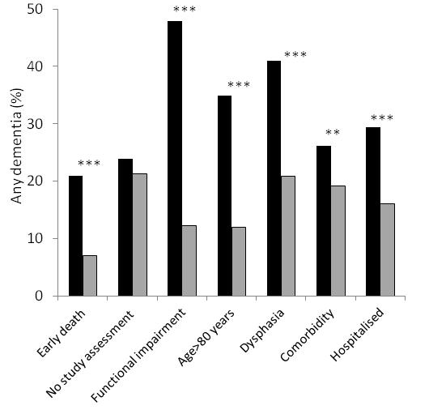
Selection Bias: Dementia rates are higher in patients commonly excluded in stroke studies

Slide 23
Importance of the systemic milieu for brain health
Blood borne factors in the systemic milieu inhibit or promote neurogenesis, synaptic plasticity, learning and memory:
Velleda et al, Nature 2012
“Maintaining an optimal milieu for neuronal function rests with supportive cells termed glia and the blood-brain barrier. Accumulating evidence suggests that neurodegeneration occurs in part because the environment is affected during disease in a cascade of processes collectively termed neuroinflammation.”
Ranshoff, Science 2016

Slide 24
Post-stroke dementia cumulative incidence to 5 years by severity of event
CI dementia
After index event
Stratified by index event severity
Stratified by recurrent event severity
After recurrent event on FU, time 0=recurrent event

Slide 25
Methodological issues in measuring cognitive impairment: cognitive tests in TIA/stroke
MMSE vs MoCA and ACE-R
Neuropsychology and measuring MCI/CIND

Slide 26
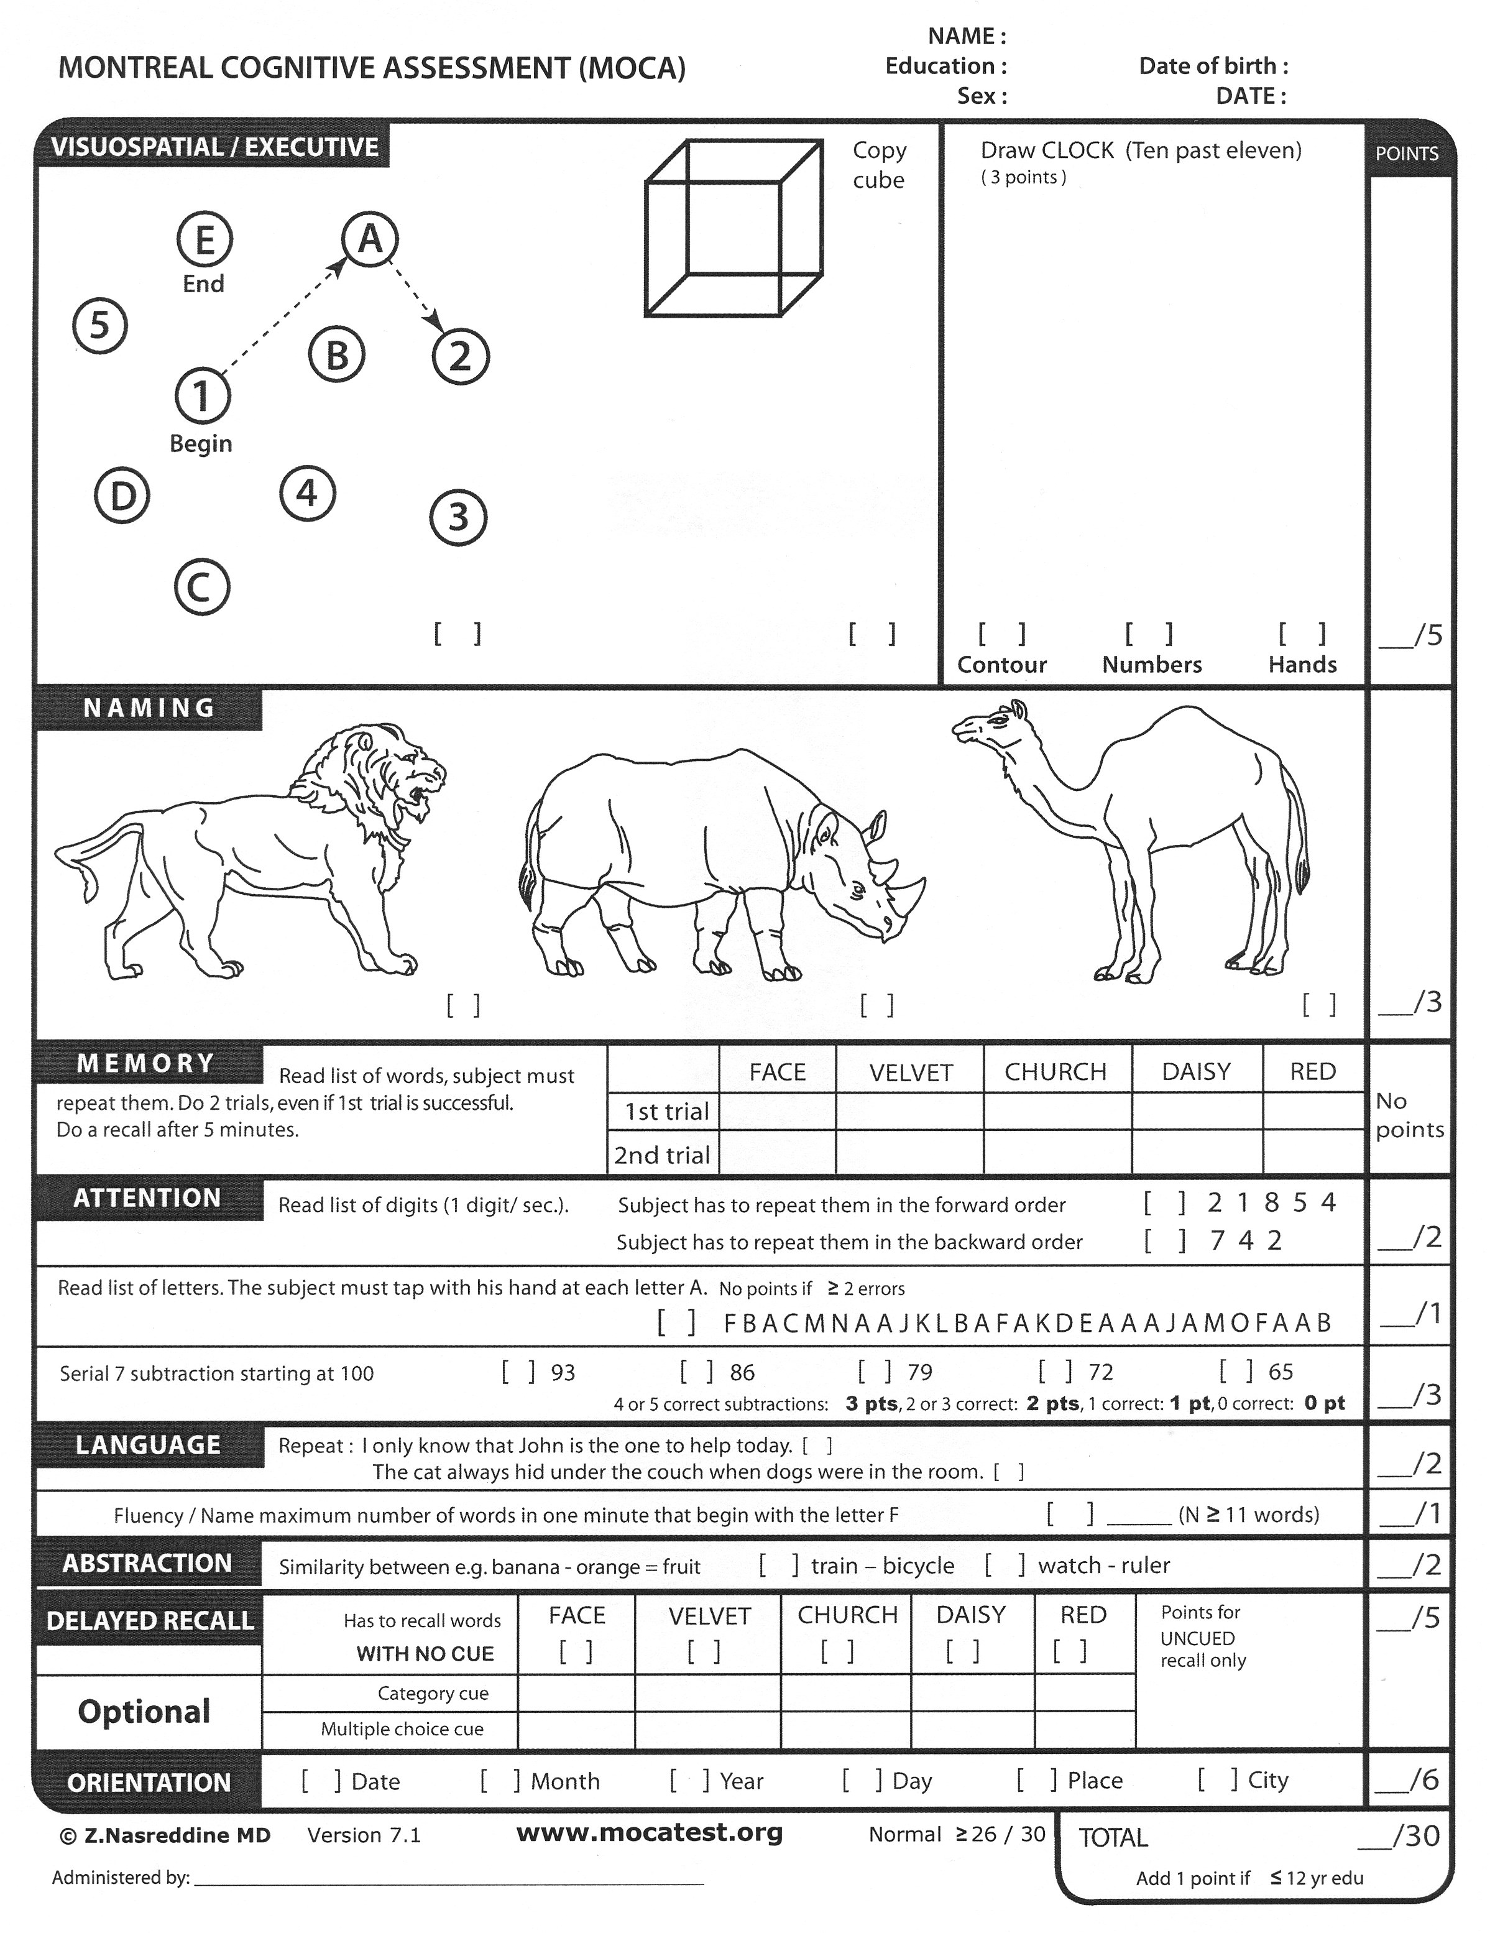
MMSE
Designed to detect dementia
Pay to use
MoCA
Designed to detect MCI
Addenbrooke’s Cognitive Examination (ACE)/100
T-MoCA
TICSm
Nasreddine et al, JAGS 2005
Desmond et al, J Geriat Psychiat. 1994.
Pendlebury et al, Stroke. 2013
Wong et al, Stroke. 2015
Notes:
26

Slide 27
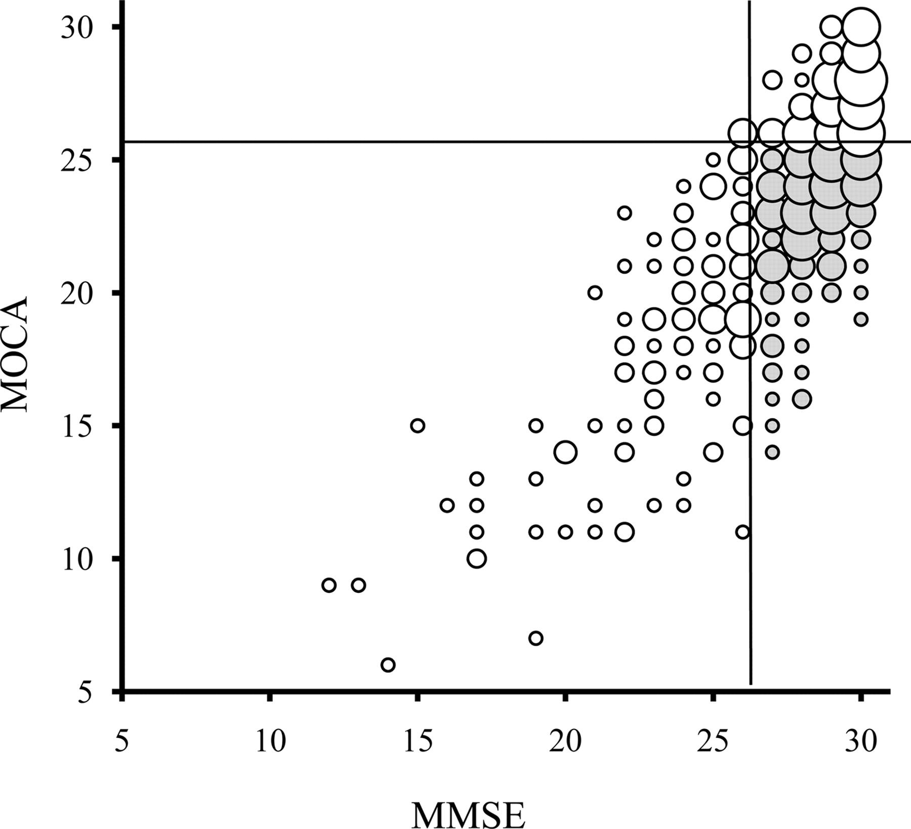
Ceiling effect of the MMSE in TIA and stroke
228 consecutive patients (48% male, mean age 72 years)
ACE is similar to MoCA
White matter ultra-structural damage correlates with MoCA more than MMSE
Stroke. 2015;46:262-4.
Zamboni et al, Stroke,in press
MMSE Median IQR 28 (26-29)
MoCA Median IQR 23 (20-26)
Stroke 2010;41:1290-3.

Slide 28
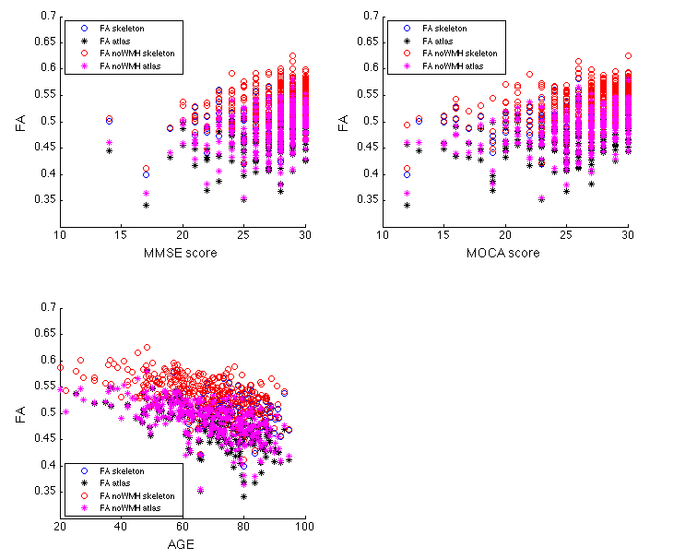
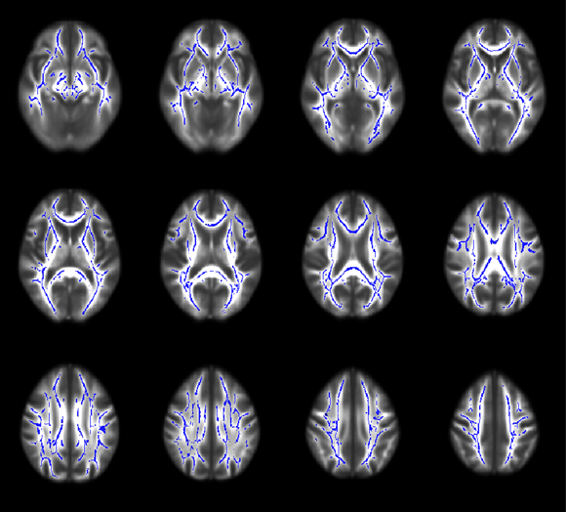
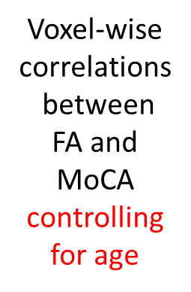
Whole-brain FA (calculated from skeleton or from atlas of WM tracts)
Zamboni et al, Stroke, in press

Slide 29
Reasons for untestability/incomplete test
Reason for untestability | Reason for incomplete test
Dysphasia | Visual impairment/deafness
Unwell/low GCS | Hemiparesis
Visual impairment/deafness | Dysphasia
Severe | Other neurological disorder
dementia | Did not finish
Acute confusion/delirium | English second language
Dysarthria | Mechanical problem eg arthritis, arm fracture
No English | Illiteracy
Declined cognitive test
Relative importance of reasons varies by time after event
Stroke.2015;46:3067-73

Slide 30
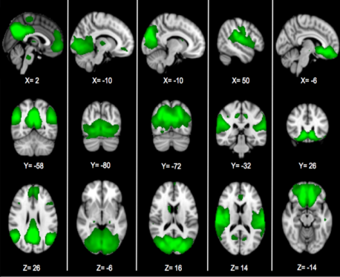
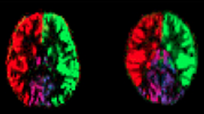
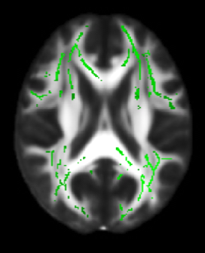
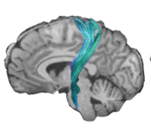

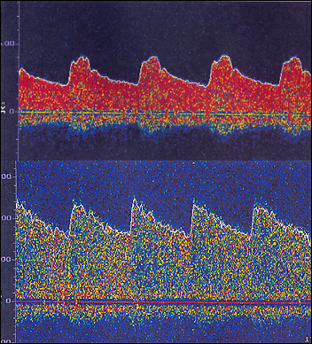
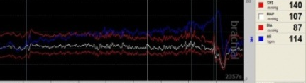
OxVASC: Cohorts
BOLD resting fMRI
OXVASC-Cog 1
2002-2007
- n=1247
- mainly CT-based
OXVASC-Cog 2
2007-2012
- n=1323
- partly MRI-based
OXVASC-Cog 3
2012-2017
- n~1500
- MRI & fMRI
- Vascular physiol.
OXVASC-Cog 4
-2017-2022
Cohorts 3 and 4
Fully-phenotyped
Brain imaging (MRI; fMRI; PET)
Vascular imaging (MRA; TCD)
Cardiac Ix (Echo, R-test)
Vascular physiology
BP monitoring
Biomarkers
Genetics
ASL fMRI
TBSS & tractography
Cardiovascular physiology
Cerebrovascular physiology

Slide 31
OxVASC : Pre- and post-event dementia
Pre-event dementia: listed/coded by GP
IQCODE
records review by STP
Post-event dementia: MMSE<24, sustained on FU
listed/coded by GP
records review by STP
(IQCODE, MOCA)
Stroke. 2014;45:3008-18

Slide 32
Baseline selection bias
Dementia rates are higher in patients commonly excluded in stroke studies
Factor present
Factor absent
Stroke. 2015;46:641-6.

Slide 33
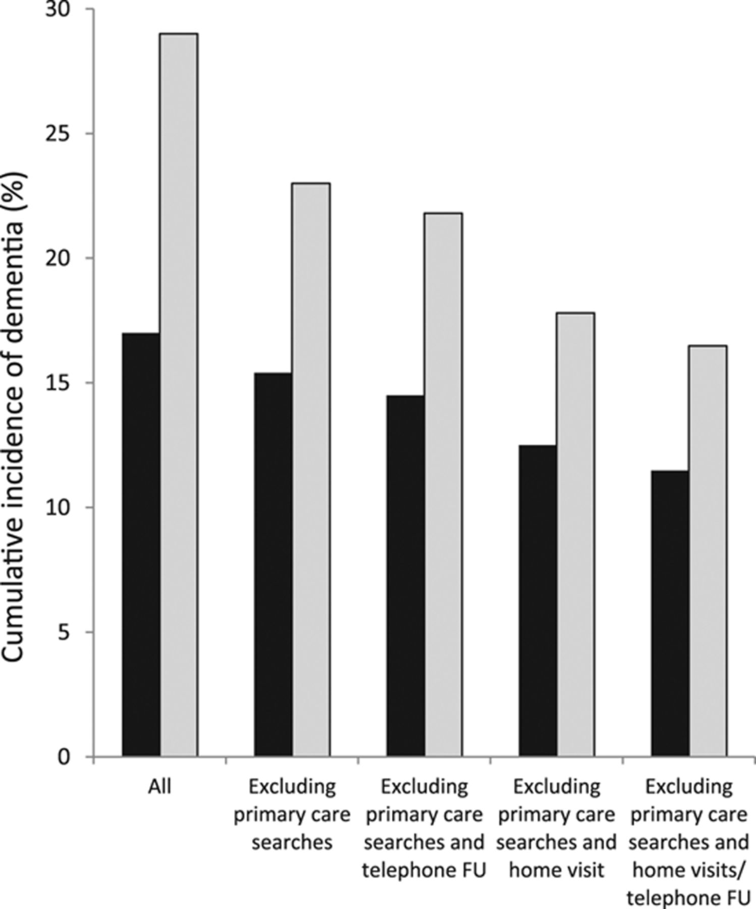
Actual OxVASC population dementia risk
Attrition over 5 years FU
Measured dementia risk if only clinic FU patients are included
1-yr (black bars) and 5-yr (grey bars) cumulative incidence of post-event dementia was 3 times higher in non-clinic vs clinic assessed pts (p<0.001)
Stroke.2015;46:1494-500.

Slide 34
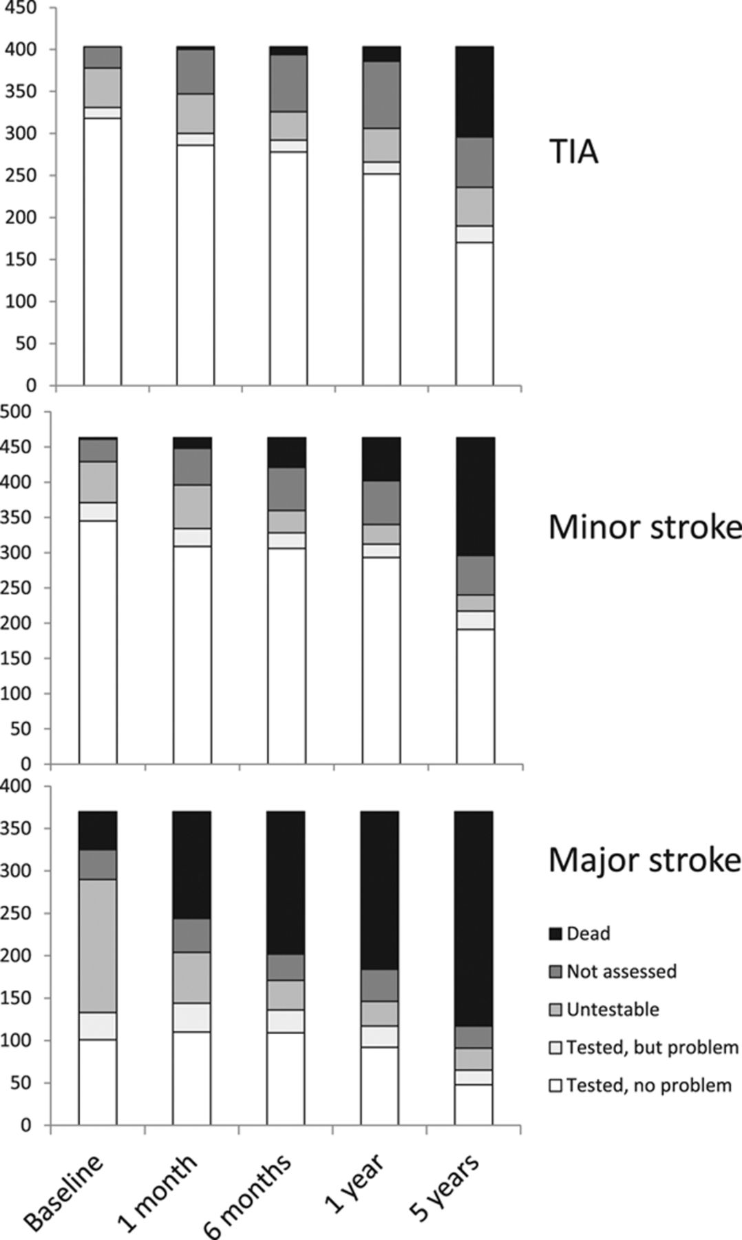
MMSE/MoCA:
Untestability/problems with testing
<50% major strokes testable at baseline vs 90% TIA
Untestability and testing problems associated with age, severity, pre-morbid dependency and death on FU
Dead
Not assessed
Untestable
Stroke 2015 46:3067-73
Int J Stroke 2015
J Neurol 2013;260:1518
Eur J Neurol 2014;21:1387.
Tested, but problem
Tested, no problem

Slide 35
OxVASC: Factors associated with pre-
and post-event dementia
OXVASC unpublished

Slide 36
Post-event dementia : mechanisms
Shared susceptibility to stroke and dementia
stepwise relationship between severity and dementia risk
genetics, mid-life vascular factors, CAA, cerebral perfusion
Brain vulnerability/reserve
age, education, leukoariosis, baseline cognitive score, previous stroke, Diabetes
Lesion impact
NIHSS
high early versus later risk
dysphasia
baseline cognitive score
Relative importance of lesion impact vs vulnerability varies with age: lesion impact is greater in young patients

Slide 37
Individual risk prediction
Risk score using above factors
Novel factors
low baseline cognitive score (TCI)
? BP variability
acute illness/delirium/infection
Imaging: DTI, resting fMRI, atrophy, amyloid
Biomarkers: inflammatory, thrombotic, cardiac
Genetics
Additional predictive value over clinical factors?

Slide 38
Delirium, transient cognitive impairment and dementia

Slide 39
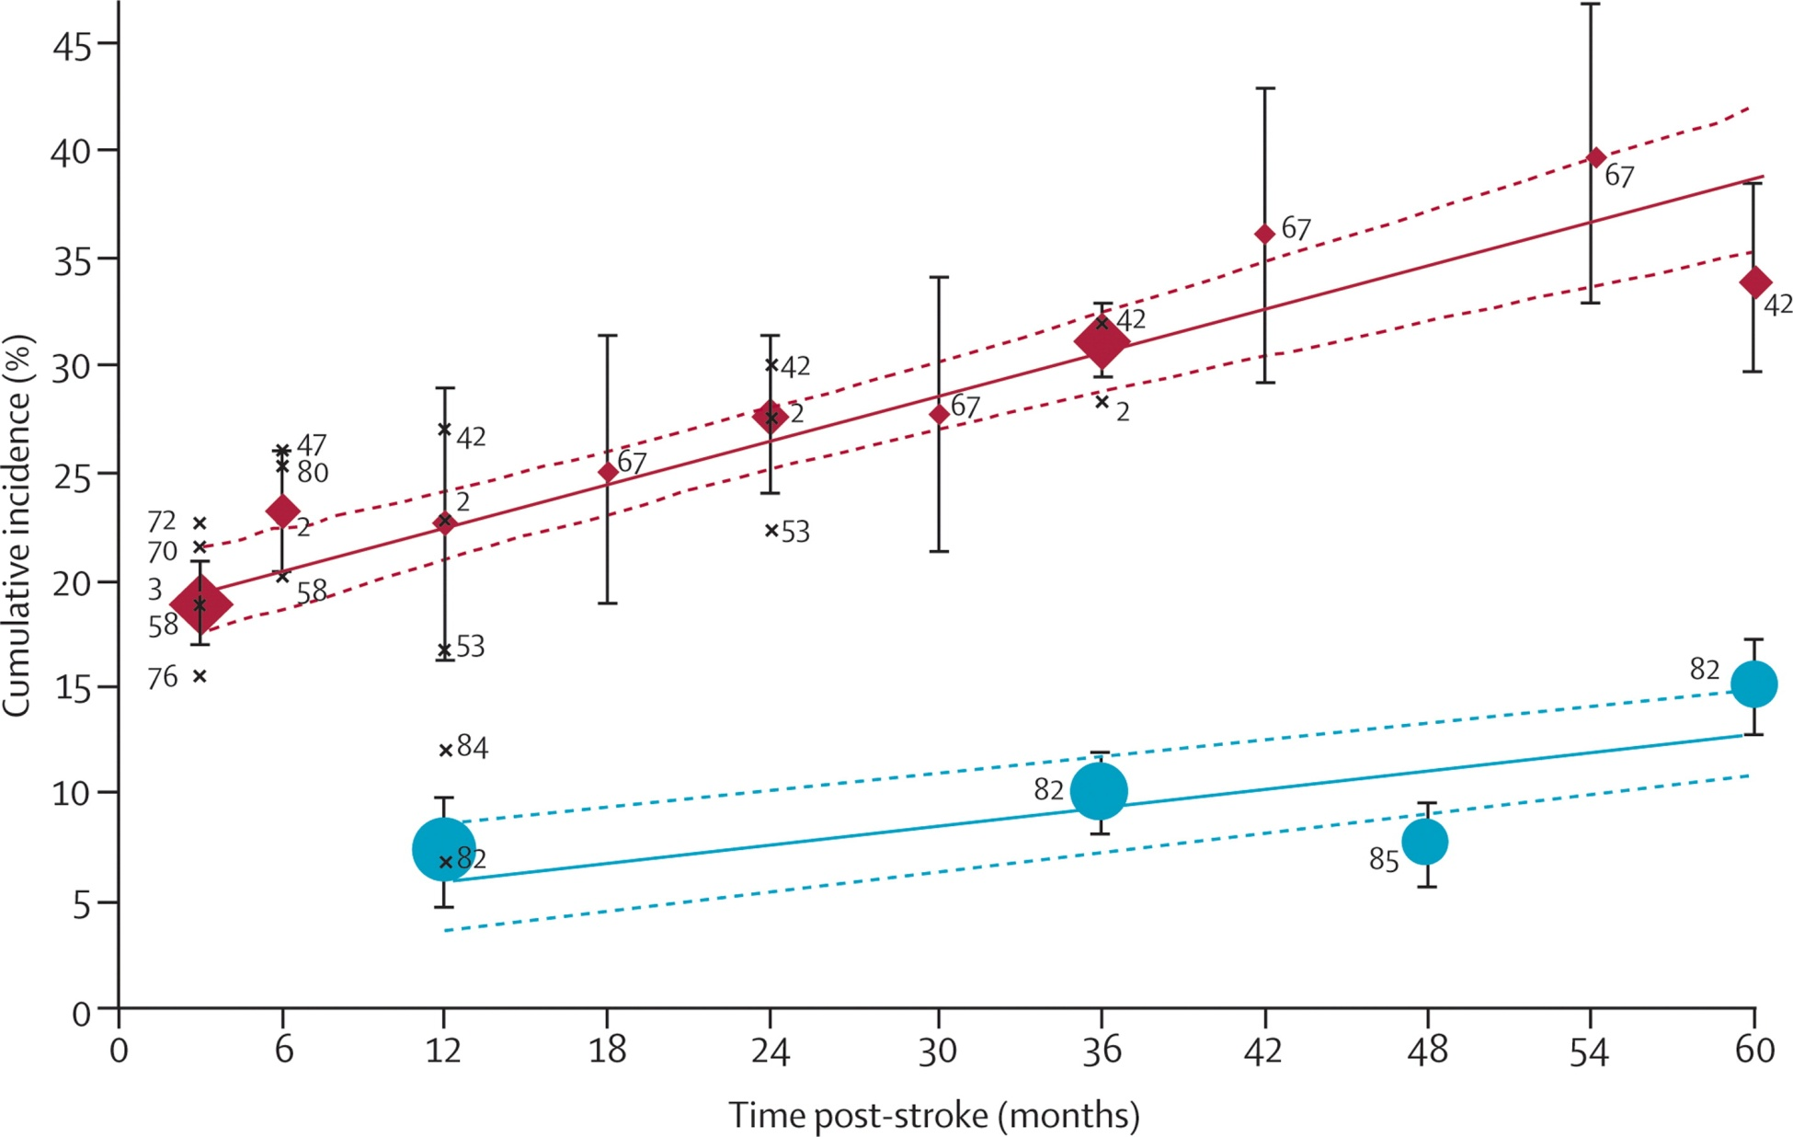
Cumulative incidence of post-stroke dementia during follow-up (excluding pre-stroke dementia)
Lancet Neurology 2009;8:1006-18

Slide 40
Total (n studies) Demented/ Prev 95%CI
Total (%)
Hospital-based, recurrent stroke, including pre-stroke dementia
Post-stroke dementia
Systematic review
Rates range: 7.4% to >40%
Case-mix is important
Similarly for post-stroke cog imp studies
Total (n studies) Demented/ Prev 95%CI
Total (%)
Hospital-based, recurrent stroke, including pre-stroke dementia
Hospital-based, any stroke, including pre-stroke dementia
Hospital-based, first ever stroke, including pre-stroke dementia
Hospital-based, any stroke, excluding pre-stroke dementia
Hospital-based, first ever stroke, excluding pre-stroke dementia
Population-based, first ever stroke, including pre-stroke dementia
Population-based, first ever stroke, excluding pre-stroke dementia
Int J Stroke 2012;7:570-81
Lancet Neurology 2009;8:1006-18

Slide 41
What can OxVASC add?
Population-based design
Almost complete ascertainment
Potential for almost complete follow-up to 10-years
TIA/minor stroke assessed acutely and managed by OxVASC team
All vascular diagnoses reviewed in real time by PMR (2002-)
Reliable risk factor ascertainment, including pre-morbid over life span
Assessment of novel potential risk factors
BP variability
acute illness, infection, delirium
frailty
co-morbidity
apathy
All dementia diagnoses made/reviewed by STP

Slide 42
OxVASC: Cohorts
BOLD resting fMRI
OXVASC-Cog 1
2002-2007
- n=1247
- mainly CT-based
OXVASC-Cog 2
2007-2012
- n=1323
- partly MRI-based
OXVASC-Cog 3
2012-2017
- n~1500
- MRI & fMRI
- Vascular physiol.
OXVASC-Cog 4
-2017-2022
Cohorts 3 and 4
Fully-phenotyped
Brain imaging (MRI; fMRI; PET)
Vascular imaging (MRA; TCD)
Cardiac Ix (Echo, R-test)
Vascular physiology
BP monitoring
Biomarkers
Genetics
ASL fMRI
TBSS & tractography
Cardiovascular physiology
Cerebrovascular physiology

Slide 43
Pre-event dementia Post-event dementia
Factors associated with pre- and post-event dementia
Also:
Frailty
Depression (previous SSRI use)
NIHSS score
OXVASC unpublished

Slide 44
Low baseline cognitive score and delirium predict poor outcome
Baseline MoCA/MMSE/AMTS predict cognitive impairment and functional outcome
Dong et al, JNNP 2012; Salvadori et al, J Neurol 2013. Dong et al, BMJ Open 2013; Pendlebury, Stroke 2013; Allan et al, Brain
Delirium after stroke predicts dementia
(Age, infection, severity)
Melkas et al, Int J Geriatr Psych. 2012
van Rijsbergen MW, J Neurol Sci. 2011

Slide 45
OxVASC: Dementia prevalence by age and event severity
Pre-event dementia prevalence
Post-event dementia incidence
dementia prevalence (%)
5-year cumulative incidence (%)
TIA
Stroke NIHSS<3
Stroke NIHSS>3
Dementia prevalence: 0.6% in TIA <65 yrs to 19.4% in stroke NIHSS>10 >75 yrs
Dementia incidence: 0.8% in TIA <65 yrs to 45% in stroke NIHSS>10 >75 yrs
Impact of event severity attenuates with age
OxVASC unpublished

