Slide 1
ECST-2: An update
ACST-2 Collaborators Meeting
Oxford, 18 September 2014
Martin M Brown
Professor of Stroke Medicine
UCL Institute of Neurology
Queen Square, London
martin.brown@ucl.ac.uk
15 mins

Slide 2
Outline of talk
Design of ECST-2
The target population
Optimised medical therapy (OMT)
Selection of patients with CAR score
Improving risk prediction
Collaboration with ACST-2
Update on recruitment in ECST-2

Slide 3
ECST-2 Design 2014
Any patient with carotid stenosis ≥50%
Legend:
CAR: carotid artery risk score
CEA: carotid endarterectomy (carotid surgery)
ECST-2: The second European Carotid Surgery Trial
FU: follow-up
m: month MRI: magnetic resonance imaging
OMT: optimised medical therapy
y: years old
Clinical screening
≥15% risk:
Carotid surgery recommended
CAR Score (to assess 5-year stroke risk)
<15% risk:
Eligible for ECST-2
MRI brain ± plaque
Ultrasound plaque
Randomisation in ECST-2
OMT
OMT plus CEA
1m, 6m, annual FU
Clinical assessment
2-year FU
Clinical assessment
MRI brain
Clinical follow-up continues for a minimum of 2 years, maximum 5 years after randomisation

Slide 4
ECST-2 Main Hypothesis
Patients with recently symptomatic carotid stenosis and a 5-year risk of future stroke of less than 15% will survive without suffering the primary endpoint at a rate that is not inferior to patients treated with by immediate revascularisation in addition to OMT
Current primary endpoint = stroke or procedural death attributed to carotid surgery
OMT=Optimised medical treatment

Slide 5
ECST-2 Secondary hypotheses
The use of brain and plaque imaging will identify a subgroup of individual patients in the trial at increased risk of recurrent stroke on OMT alone, who in future would be better managed by adding carotid revascularisation to OMT.
The proportion of elderly patients who develop cognitive decline will be less in those treated with OMT alone than in those subjected to carotid revascularisation.

Slide 6
Outline of talk
Design of ECST-2
The target population
Optimised medical therapy (OMT)
Selection of patients with CAR score
Improving risk prediction
Collaboration with ACST-2
Update on recruitment in ECST-2

Slide 7
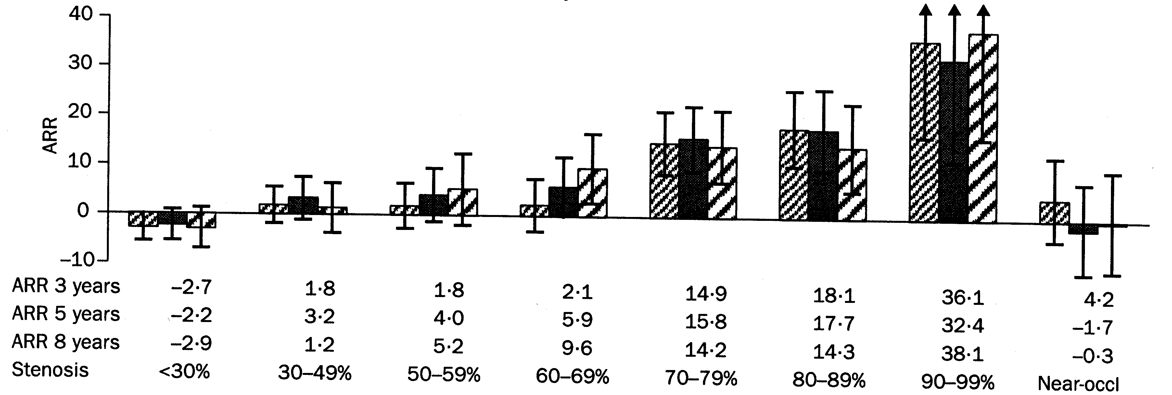
Absolute risk reduction with surgery at different degrees of stenosis (NASCET measurement) Ipsilateral stroke and any operative stroke or death
Combined analysis of the ECST, NASCET & VA trials (1981-96) Rothwell P et al. Lancet 2003;361:107-116
Notes:
7

Slide 8
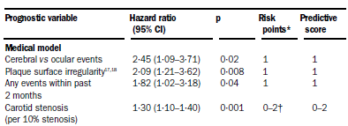
ECST: Model to predict stroke on medical treatment
Rothwell & Warlow Lancet 1999;353:2105-2101

Slide 9
Reliability of ECST predictive model of 5 year risk of ipsilateral stroke in NASCET
50
Patients on medical treatment in NASCET
40
30
Observed risk (%)
Risk of CEA in NASCET
20
10
0
0
10
20
30
40
50
Predicted medical risk (%)
Error bars represent 95% CIs.
Rothwell PM. Lancet 2005; 365: 256–265

Slide 10
Reliability of ECST predictive model of 5 year risk of ipsilateral stroke in NASCET
50
No clear benefit of CEA with predicted risk <15%
Patients on medical treatment in NASCET
40
30
Observed risk (%)
Risk of CEA in NASCET
20
10
0
0
10
20
30
40
50
Predicted medical risk (%)
Error bars represent 95% CIs.
Rothwell PM. Lancet 2005; 365: 256–265

Slide 11
Outline of talk
Design of ECST-2
The target population
Optimised medical therapy (OMT)
Selection of patients with CAR score
Improving risk prediction
Collaboration with ACST-2
Update on recruitment in ECST-2

Slide 12
Is the selection of patients for CEA on the basis of the results of old trials still valid? Medical treatment has improved
Better antiplatelet therapy
Clopidogrel or aspirin plus dipyridamole
Lower targets for blood pressure control
Smoking has declined
Widespread use of statins with cholesterol targets

Slide 13
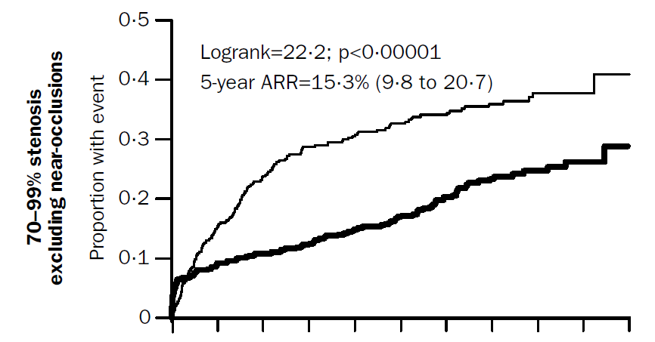
Early risk of recurrent stroke in ECST, NASCET & VA trials
Any stroke or operative death
medical group
endarterectomy group
7% risk in medical group at 120 days
5
10
years
Rothwell P et al. Lancet 2003;361:107–116
Notes:
13

Slide 14
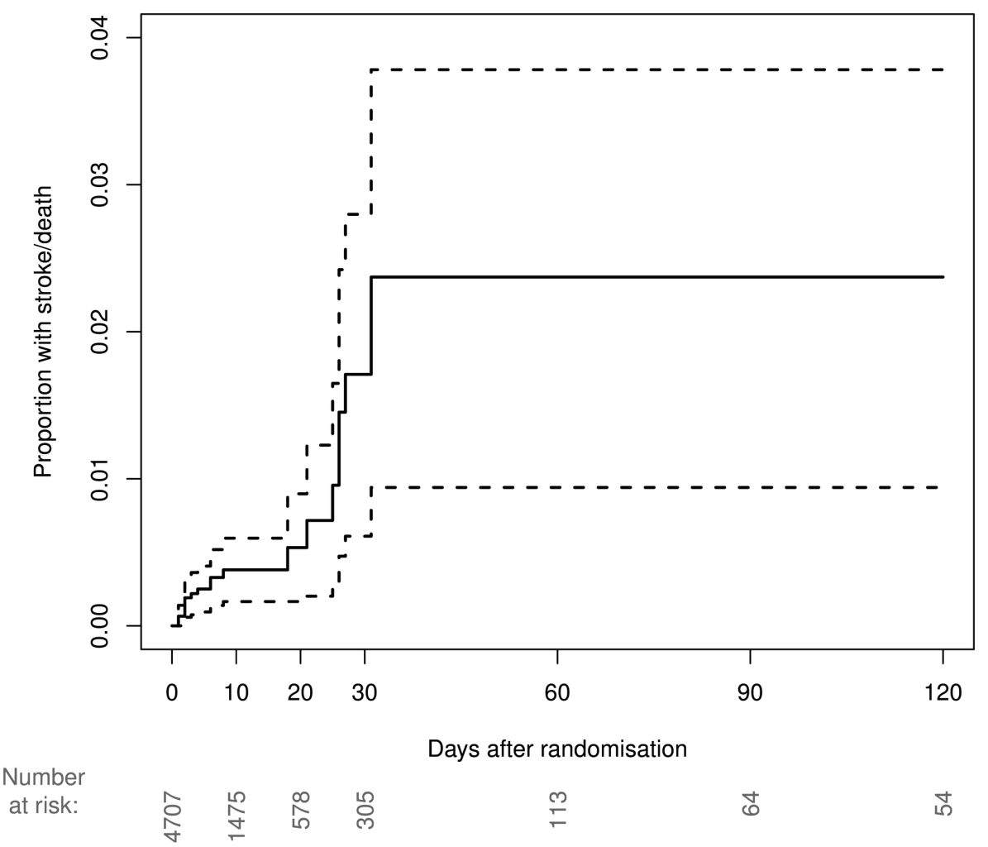
Risk of stroke or death before surgery or stenting: pooled analysis of recently symptomatic carotid stenosis in CREST, EVA-3S, SPACE & ICSS
2.3% risk at 120 days
Proportion with stroke or death
Days after randomisation
Bonati L et al for CSTC. Presented to ISC, San Diego, Feb 2013

Slide 15
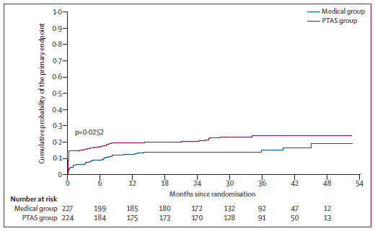
SAMMPRIS trial: stenting vs. ‘aggressive’ medical treatment alone for symptomatic intracranial artery stenosis >70%
n=451
p=0.0252
Primary event rate at 2 years in medical group= 14.1%
31/34 events were ipsilateral stroke
Primary endpoint = stroke or death within 30 days after enrolment, ipsilateral stroke beyond 30 days of enrolment, or stroke or death within 30 days after any revascularisation of the qualifying lesion
Derdeyn CP et al. Lancet 2014;383:333-341

Slide 16
Stenting and Aggressive Medical Management for preventing Recurrent Stroke in Intracranial Stenosis (SAMMPRIS) trial
Stenting used the Wingspan stent system
All patients had ‘aggressive’ medical therapy
Aspirin + clopidogrel (for first 90 days)
Antihypertensive treatment - target SBP <140mmHG or <130mmHg if diabetic
Rosuvostatin - target LDL-C <1.81mmol/L [70mg/dl]
Management of other risk factors
Lifestyle coach contacted patients by telephone 2 weekly for 3 months, then monthly

Slide 17
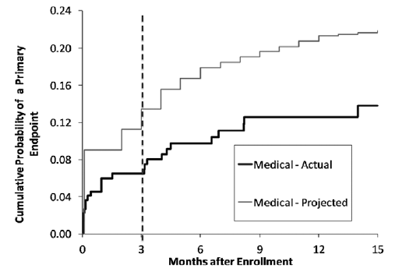
Expected rate of outcome events projected from WASID vs. actual rates in SAMMPRIS
CLOP + ASA
ASA alone
Chimowitz M. Stroke 2013;44:2664-2669

Slide 18
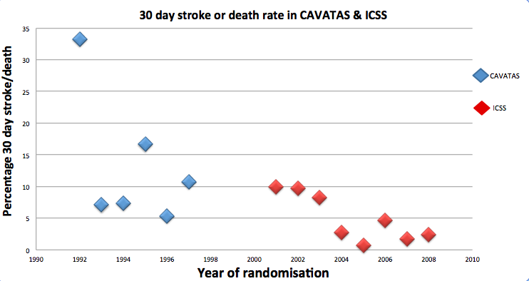
Annual perioperative risk of stroke or death after CEA for symptomatic stenosis in CAVATAS & ICSS from 1993 to 2008
p=0.018 in ICSS (logistic regression)
The risks of carotid endarterectomy have declined: an analysis of two trials with similar protocols. Kennedy et al. ESC, Poster Session Red 29th May 2013

Slide 19
Outline of talk
Design of ECST-2
The target population
Optimised medical therapy (OMT)
Selection of patients with CAR score
Improving risk prediction
Collaboration with ACST-2
Update on recruitment in ECST-2

Slide 20
Carotid Artery Risk (CAR) score
Rothwell ECST-2 prediction model recalibrated to take account of benefits of modern Optimised Medical Therapy (OMT)
We have called this new prediction score the Carotid Artery Risk (CAR) Score
Predicts 5 year-risk of ipsilateral stroke in patients with carotid stenosis > 50% treated with OMT alone
Adapted to include asymptomatic stenosis

Slide 21
Baseline characteristics used to calculate the Carotid Artery Risk (CAR) Score
Sex
Degree of stenosis – presence or absence of near occlusion
Plaque morphology – smooth or rough/ulcerated
Age
Time since most recent event
Most severe ipsilateral event (non disabling stroke, retinal infarct, single or multiple TIAs)
Diabetes
Previous myocardial infarction
Peripheral vascular disease
Hypertension

Slide 22
How many patients currently referred for CEA have a low predicted risk of stroke on OMT? Analysis of patients included in ICSS – a trial of CEA vs CAS for symptomatic carotid stenosis
100%
80%
Cumulative percentage of CEA
Patients
60%
CAR score assuming smooth plaque
40%
N=821
20%
0%
0
15
30
45
CAR score (%)
(predicted 5 year ipsilateral stroke risk on OMT)

Slide 23
Predicted risk of ipsilateral stroke on OMT alone vs. observed risk of ipsilateral stroke plus perioperative stroke or death in ICSS
5-year event rate
p=0.029
20%
16%
Predicted risk on OMT alone
12%
p=NS
8%
Observed risk in ICSS in those allocated CEA
4%
0%
CAR<15%
CAR ≥15%
n=674
n=147
CAR score in CEA patients assuming smooth plaque

Slide 24
Outline of talk
Design of ECST-2
The target population
Optimised medical therapy (OMT)
Selection of patients with CAR score
Improving risk prediction
Collaboration with ACST-2
Update on recruitment in ECST-2

Slide 25
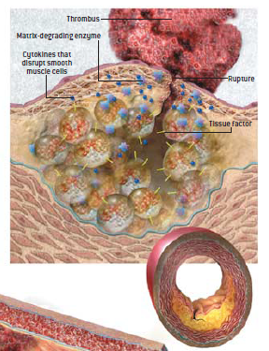
What causes atherosclerotic plaque to rupture or ulceration?
Inflammation and activation of macrophages in lipid core
Rupture or ulceration of fibrous cap precipitates thrombosis
Release of cytokines and enzymes which thin the fibrous cap
Vulnerable plaque likely to rupture and cause stroke will have haemorrhage, active macrophages and/or a thin fibrous cap

Slide 26
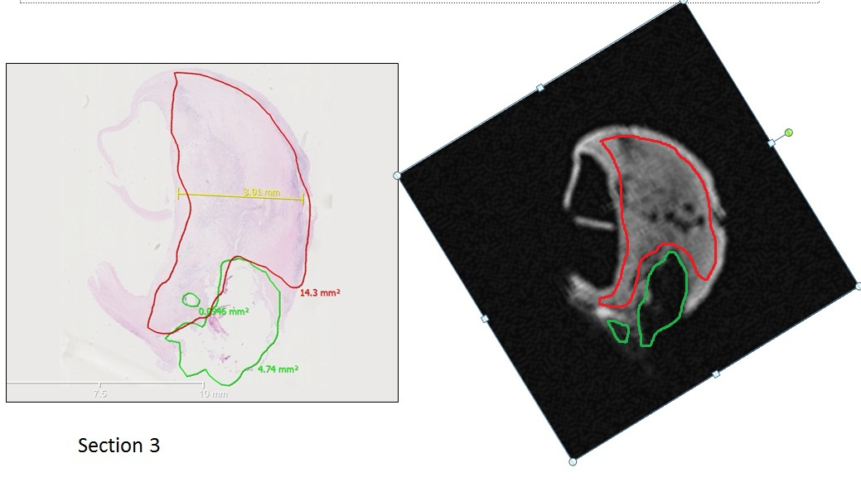
Key question for current research: can we identify vulnerable plaque by in-vivo imaging (MR, Ultrasound, PET)?
Correlation of histology with ex vivo 9.4T MRI at UCL
Green = calcium
Red = lipid core

Slide 27
ECST-2 Imaging secondary hypothesis
The use of brain and plaque imaging will identify a subgroup of individual patients in the trial at increased risk of recurrent stroke on OMT alone, who in future would be better managed by adding carotid revascularisation to OMT.

Slide 28
Secondary studies in ECST-2 Improving risk prediction in carotid disease
Development and testing of clinical scores
Brain MRI to predict risk of revascularisation/OMT
3-D Ultrasound to predict risk of revascularisation/OMT
MRI plaque imaging to predict risk of revascularisation/OMT
? TCD emboli detection to predict risk
? PET plaque imaging to predict risk
Combine different modalities to improve prediction
Test the models developed in other trials
Notes:
28

Slide 29
Outline of talk
Design of ECST-2
The target population
Optimised medical therapy (OMT)
Selection of patients with CAR score
Improving risk prediction
Collaboration with ACST-2
Update on recruitment in ECST-2

Slide 30
Collaboration with ACST-2 (and other trials)
ECST-2 and ACST-2 are complementary
We have joint stands at vascular meetings and support recruitment to both studies at our centres
Joint application for future funding for ECST-2 in elderly symptomatic patients submitted to EU Horizon 2020 program with ACST-2, EVA-3S and SPACE-2 investigators

Slide 31
High Risk
(CAR score ≥ 15%)
Symptomatic at low or intermediate risk
(CAR score < 15%)
Asymptomatic or no symptoms for >180 days
Uncertain re inter-vention
Certain re inter-vention
ECST-2
ACST-2
Intervention within 2 weeks (CEA or CAS) plus OMT
Randomise to OMT alone vs. CEA or CAS plus OMT
Randomise to CEA plus OMT vs. CAS plus OMT

Slide 32
Update on recruitment in ECST-2
9 centres enrolled
57 patients randomised
New centres welcome
Funded from NIHR and Stroke Association until April 2017 (n=320 patients)

